Slide 1
GST: A General SpMM Design based on Tensor Core
2023/12/5

Slide 2
Introduction
We point out that a static specific design for special functions does not always improve the performance of SpMM on different architectures. (e.g., Specific instructions have substantially reduced performance on other target architectures).
In this work, we consider the challenge of design of SpMM for generality:
Input Generality:
Architecture Generality:
Performance Efficiency:
Contribution:
Establish a hypergraph model for the sparse matrix line reorder problem, and achieve a sparse format for utilization
Analyze the computational characteristics and execution instructions of different versions of Tensor Core to find a universal method. Design SpMM kernels that are compatible with more architectures.
Propose GST SpMM that can adapt to input and architecture while ensuring efficient and stable performance.

Slide 3
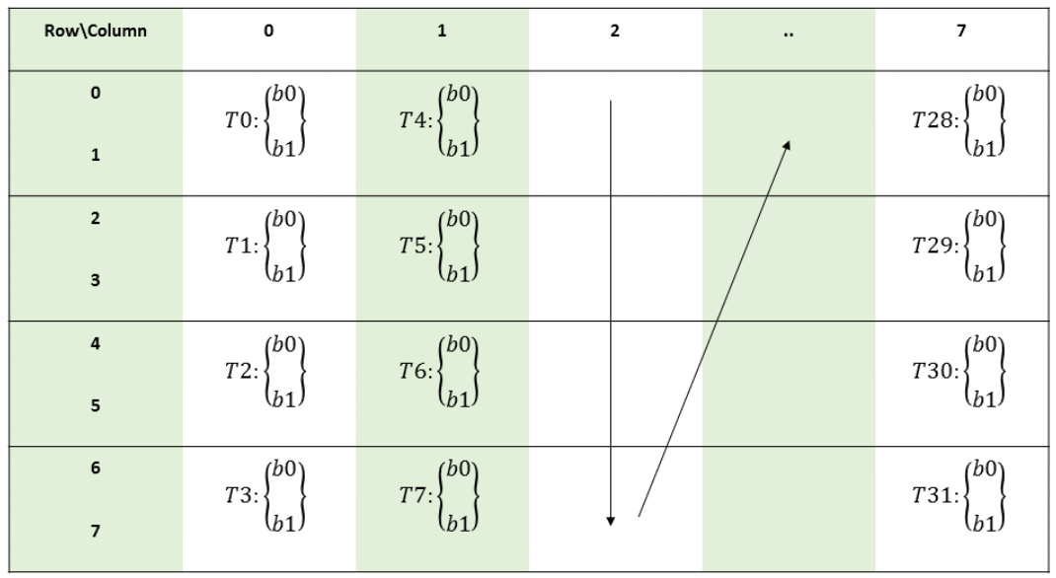
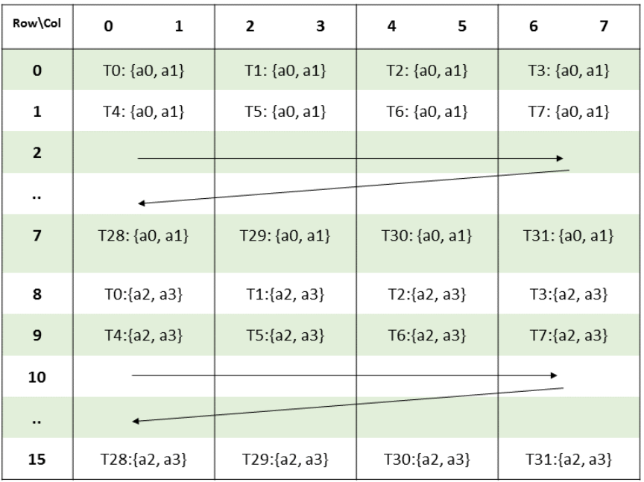
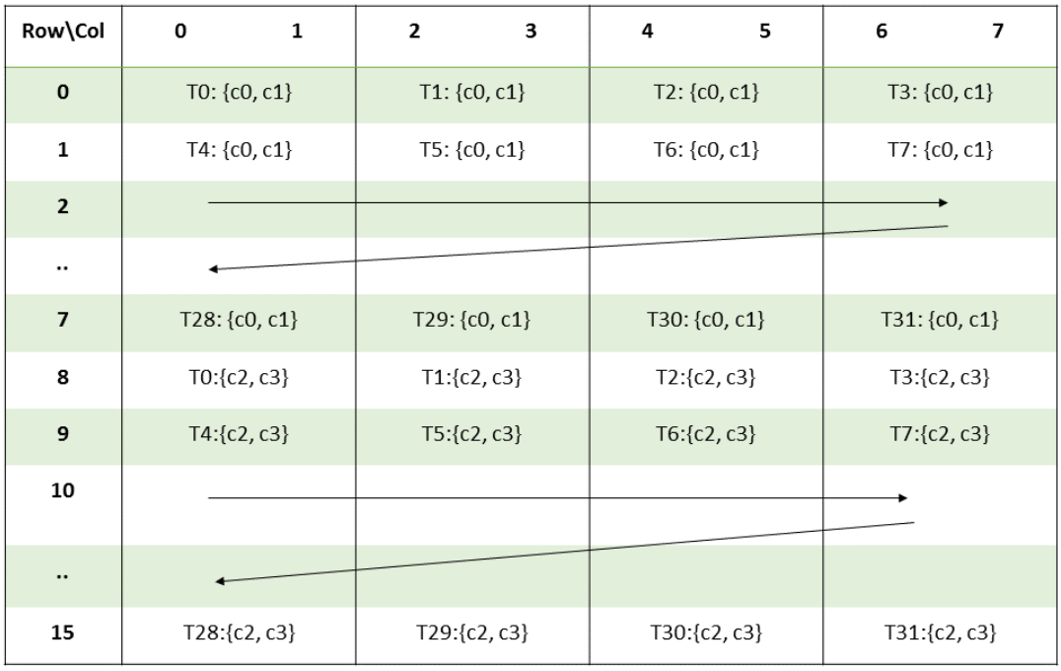
Background
Tensor Core and its Programming
Design Principles for SpMM Design
Compression Format and Data Pre-processing
Inst | Shape | PTX ISA Version | Involved Thread
wmma | .m16n16k16 | PTX ISA Version 6.0 | 32
 | .m8n32k16
 | .m32n8k16
mma | .m8n8k4 | PTX ISA Version 6.4(sm >=70) | 8
 | .m16n8k8 | PTX ISA Version 6.5(sm>=75) | 32
 | .m16n8k16 | PTX ISA Version 7.0(sm>=80) | 32

Slide 4
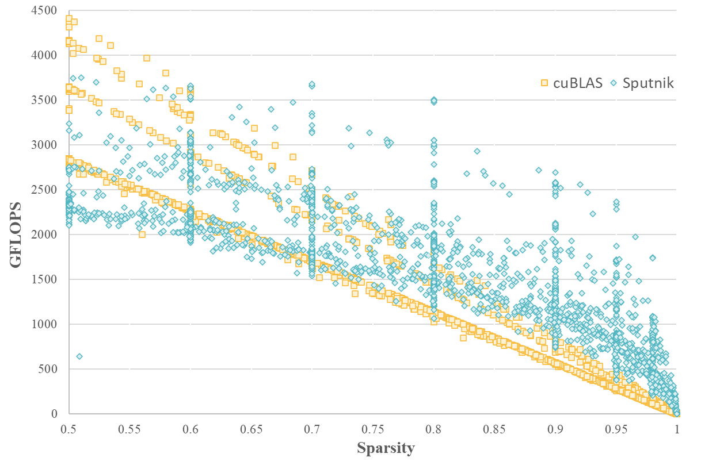
Contribution1:同时满足结构化和非结构化SpMM操作的设计
对稀疏矩阵换行问题建立超图模型(hypergraph)
对超图问题求解，计算Tensor Core的利用率，当V=16时，利用率更高，更能发挥其算力
0
1
2
3
4
5
6
7
0
1
2
3
4
5
6
7
0
2
1
4
3
7
6
5
directly
Hypergraph
Reorder
In the performance comparison between various sparse and dense libraries, only when the sparsity exceeds 80%, can the sparse library stably surpass the performance of the dense library. Therefore, this work only discusses the case of sparsity>80%.
1D-Vector
Sparsity
Fine-grained
Sparsity
1D-Vector
Sparsity

Slide 5
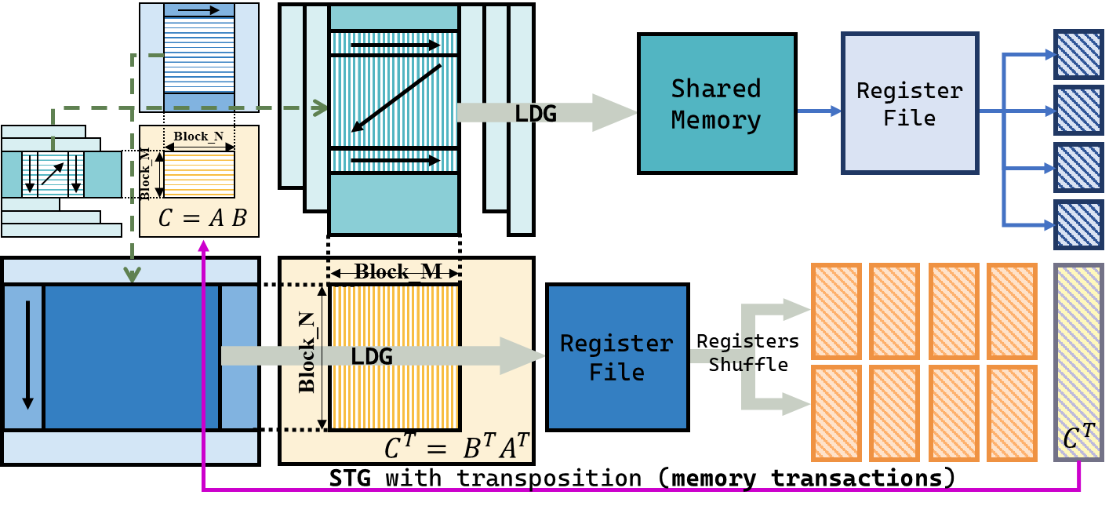
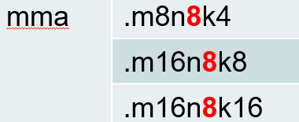
Contribution2：compatible with more architectures
Analyze the computational characteristics and execution instructions
of different versions of Tensor Core: //TODO
问题：需要理论支持
为了满足1-D vector sparsity的特性，需要将M维尽量缩小。
虽然mma指令中的M维不固定且较大，但是N维固定为8，满足格式要求。
因此，利用转置实现多架构通用。

Slide 6
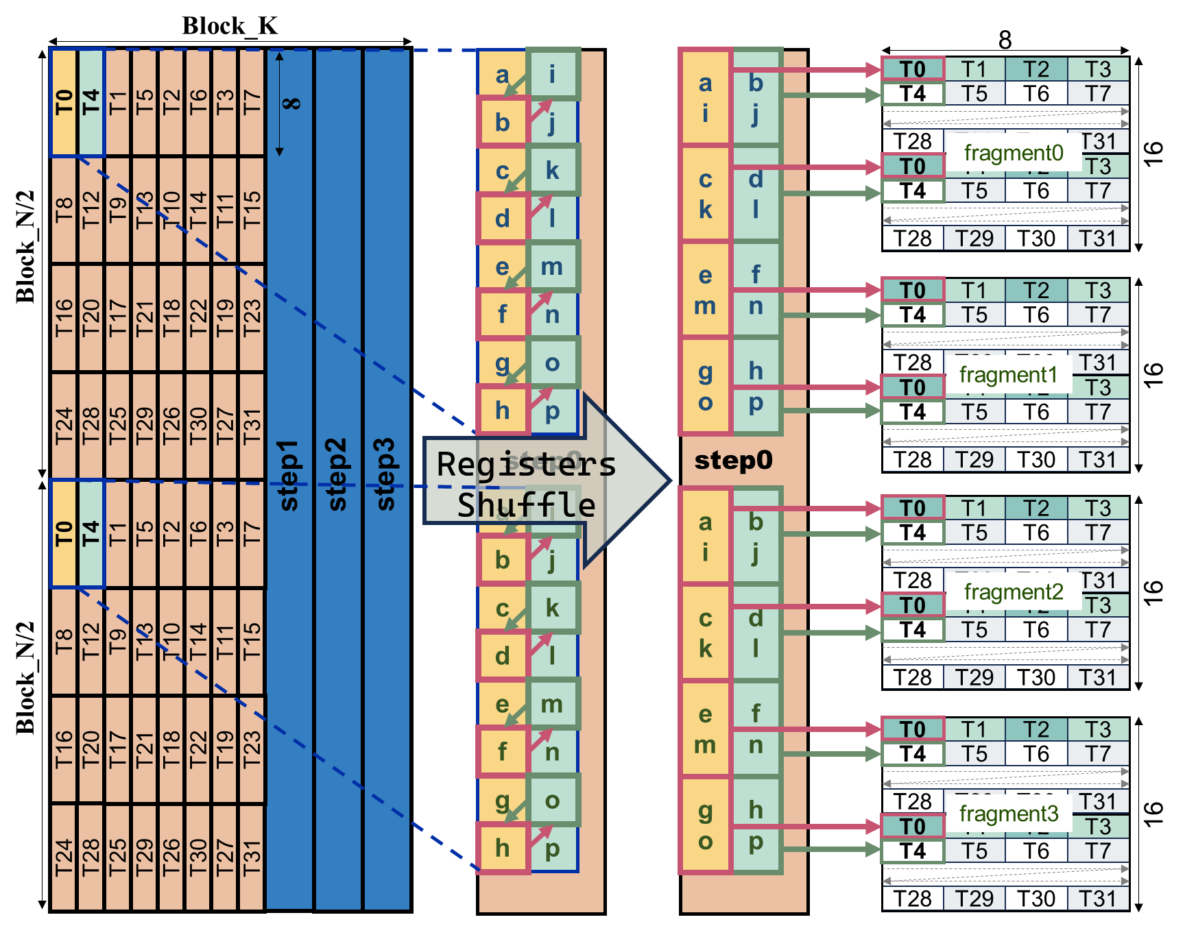
Contribution3：GST SpMM Implementation
通常的数据映射有
Row-Balance(一个线程对应一行)、
Element-Balance(一个线程对应固定元素)
而这里采用
multi-row mapping + registers shuffle，
实现对数据的无开销转置。（这里最后可以加一个消融实验）

Slide 7
Contribution3：GST SpMM Implementation
GST-SpMM
mma
mma.884
transpose
mma.1688
transpose
wmma
wmma.161616
mma.884
mma.1688
1-D Vector
1-D Vector
Fine-grained
Fine-grained
wmma.83216
Fine-grained
1-D Vector
Fine-grained
Lib | 1stTC | P-F | 2ndTC | P-F | 3rdTC | P-F | 4th TC | P-F
vectorSparse | P | P | P | O | P | O | P | O
magicube | O | O | P | ? | P | ? | P | ?
mma-GST | O | O | P | P | P | P | P | P
wmma-GST | P | ? | P | ? | P | P | P | P

Slide 8
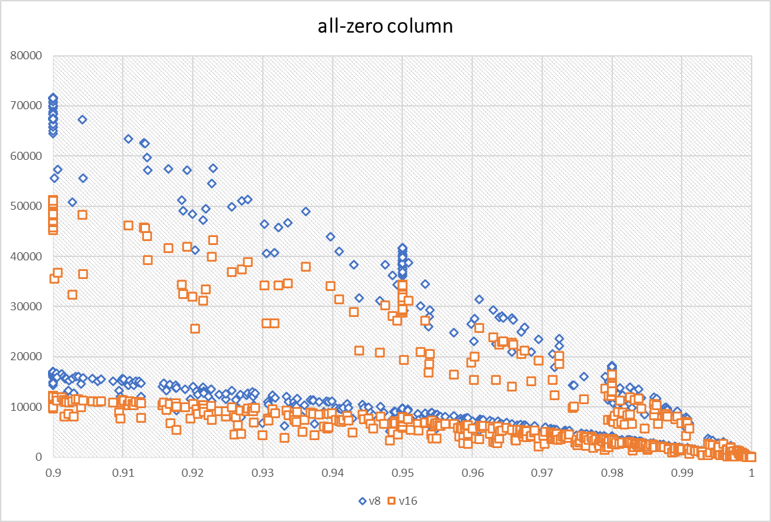
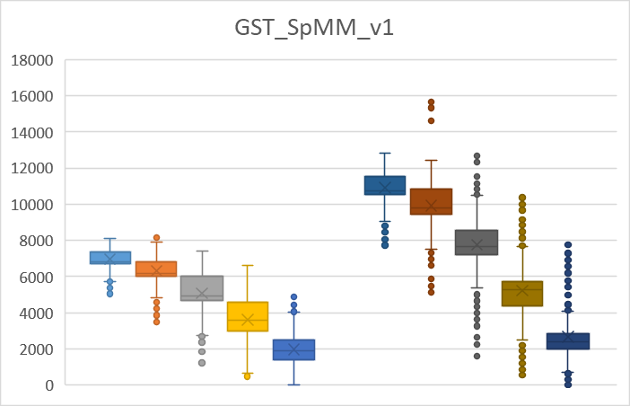
Evaluation
V=8 V=16
实验一：
求解超图模型，对比V=8和V=16的利用率
设计满足V=16的算子。 实验二：对比V=16和V=8的性能。
实验三：消融实验，对比采用不同映射的性能差距
实验四：WMMA与mma指令的对比
实验四：最终GST_SpMM在四种Tensor Core上能实现均超过vectorSparse
实验五：与不同库的不同计算模式对比

Slide 9
Thanks for listening
2023/12/5

